Slide 1
C for Java programmers
CS 3335, Fall 2017
Dr. Zhiguang Xu

Slide 2
subjects
Let’s get the basics out of the way…
Write a C program and compile it with GCC
Basic data types and sizeof()
Functions
Control flows and logic operators
Standard library
Bit manipulations

Slide 3
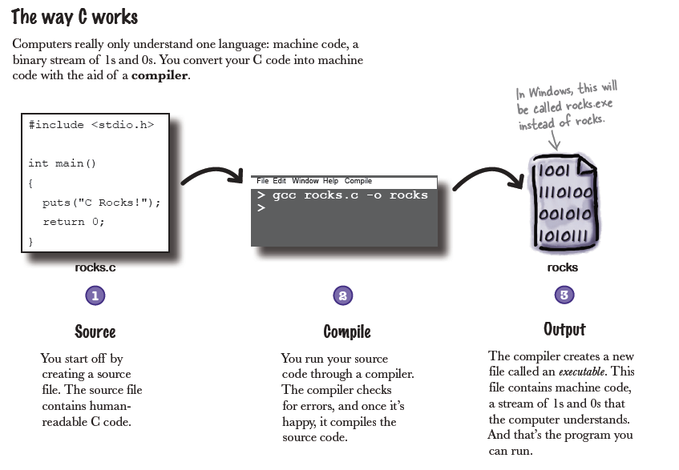
Write, compile, and run a c program
directive
preprocess, compile, and link

Slide 4
C Basics (1)
Code fragments on page 3
The #include preprocessing directive
Data types int, char, …
A string (array of characters) in C ends with ‘\0’
The sentinel character ‘\0’ is to help C know the length of the string
More later…
Selections and loops
Comments
scanf() and printf()

Slide 5
C Basics (2)
A complete C program on page 5
int main(void) function where void is usually omitted
Another form of main will be covered later: int main(int argc, char *argv[])
scanf (“%i”, &deck);
Code magnets on page 7
The rest of the chapter covers subjects like selections, (short circuit) logic operators, the switch statement, loops, break, and continue.
It ends up with the code on page 37. Make sure you don’t have any problem understanding it.
C is a very small language. Find the entire set of reserved words on page 181.
The second argument needs to be an address. (More on this later …)

Slide 6
A close look at Basic DATA types in C
char
Stored in one byte
More on next page…
Integral types (default to signed)
short, int, long, and long long
signed, unsigned
floating types (default to double)
float (4 bytes), double (8 bytes), and long double (10 bytes)
All floating point numbers are signed
In C, false is represented by any zero (0, 0.0, ‘\0’, NULL) and true is represented by non-zero expressions.
Math functions
#include <math.h>
Add the –lm option to the gcc command
 | short | int | long
32-bit machine | 2 bytes |  | 4 bytes
64-bit machine | 2 bytes | 4 bytes

Slide 7
Char Type promotion
char could be signed or unsigned, which is system-dependent
To find it out on your system, #include <limits.h> and print out CHAR_MIN
limits.h also contains max/min/size values for the integer types, whereas float.h contains such values for floats and doubles
char (and also short) expressions are always promoted to int before being processed
Unsigned char (and unsigned short) gets 0s padded to the left
Sign extension occurs on signed quantities
Constants like ‘a’, ‘+’, EOF, are of type int instead of char
Functions (well, “macros”) in ctype.h

Slide 8
A close look at strings in C
Array of char terminated by ‘\0’
Let’s see an example
char s1[] = “Shatner”;
s1 is an array variable which stores the address of the first character
sizeof(s1) is 8 bytes whereas strlen(s1) is 7
char s2[20] = “Shatner”;
sizeof(s2) is 20 bytes whereas strlen(s2) is 7
A closer look at strings in memory later…
Functions in string.h
A string literal:
‘S’ ‘h’ ‘a’ ‘t’ ‘n’ ‘e’ ‘r’ ‘\0’

Slide 9
Bit manipulation
Important to system programming, image processing, networking, and other apps where efficiency is a priority.
Bitwise operators
Logical operators | (Unary) bitwise complement | ~
 | Bitwise and | &
 | Bitwise or | |
 | Bitwise exclusive or | ^
Shift operators | Left shift | <<
 | Right shift | >>

Slide 10
Bitwise complement
Inverts the bit string representation of its operant – One’s complement
Application – Two’s complement
Bitwise complement the bit string, then add 1 to it.
Value of n | Binary rep. | Bitwise complement of n | Two’s complement rep. of -n | Value of -n
7 | 00000000 00000111 | 11111111 11111000 | 11111111 11111001 | -7
8 | 00000000 00001000 | 11111111 11110111 | 11111111 11111000 | -8
-7 | 11111111 11111001 | 00000000 00000110 | 00000000 00000111 | 7
Add 1
Note: to save space, only the two low-order bytes are shown.

Slide 11
Bitwise Binary logical operators
Some examples
~(a|b) == (~a & ~b)
~(a&b) == (~a | ~b)
a | b | a&b | a|b | a^b
0 | 0 | 0 | 0 | 0
1 | 0 | 0 | 1 | 1
0 | 1 | 0 | 1 | 1
1 | 1 | 1 | 1 | 0

Slide 12
Left- and right- shift operators
exp1 << exp2, exp1 >> exp2
exp1 must be an integral exp.
exp2 must be a positive integer
<<: 0’s are shifted in
>>:
0’s are shifted in for unsigned types
System dependent for signed. (Run rightshift.c to find it out on your machine. )
Therefore, to avoid ambiguity, use unsigned types when using bitwise operators.)
Check this out: https://rebrand.ly/bitsheb56

Slide 13
BIT Masks
A mask is a constant or variable used to extract/set/toggle desired bits in another variable or exp.
The simplest bit mask has only one bit (which is also called a bit flag)
E.g. int mask = 1; Then(v & (mask << 2)) ? 1: 0 has the value 1 or 0 depending on the third bit in v.
Examples
bit_print()
pack()
unpack()
getbits()
More to read
http://www.catonmat.net/blog/low-level-bit-hacks-you-absolutely-must-know/
http://codeforces.com/blog/entry/18169

